Slide 1
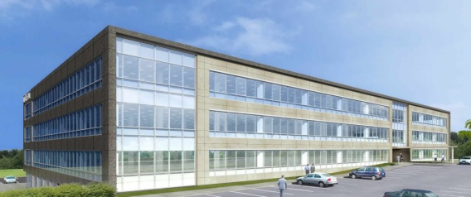
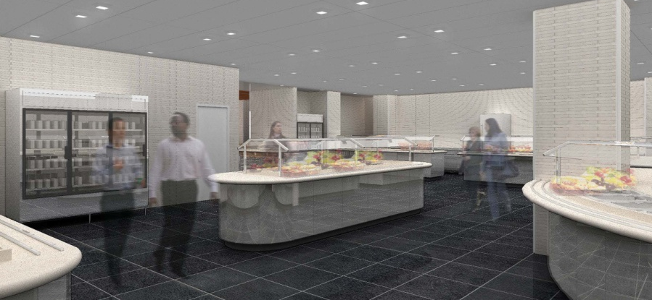
50 Connell Drive
Berkeley Heights, NJ
AE Senior Thesis 2009
April 14th, 2009

Slide 2
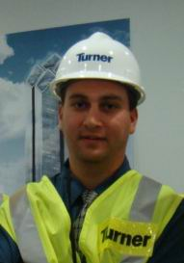
About Myself
Jason Salyer
Construction Management
Program
5th year Penn State AE
Hometown
Poughkeepsie, NY
Professional Experience:
Whiting-Turner 2007
Loyola Dormitory
Turner Construction 2008
WTC Tower 2

Slide 3
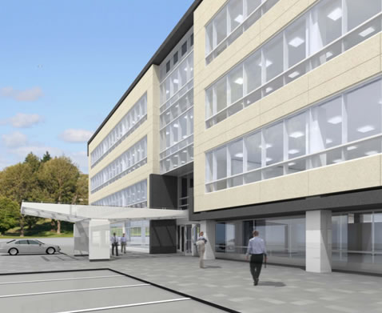
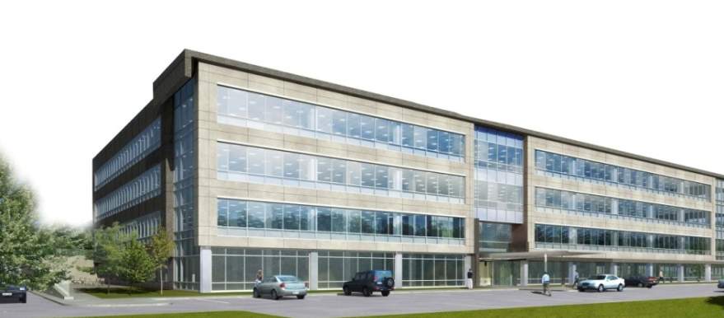
Topics to be Presented
Analysis 1 – Panelized Façade System
Analysis 2 - High Performance Glazing
Analysis 3 - Prefabrication
Industry Issue - Reducing Operating Costs
50 Connell Drive
Berkeley Heights, NJ

Slide 4
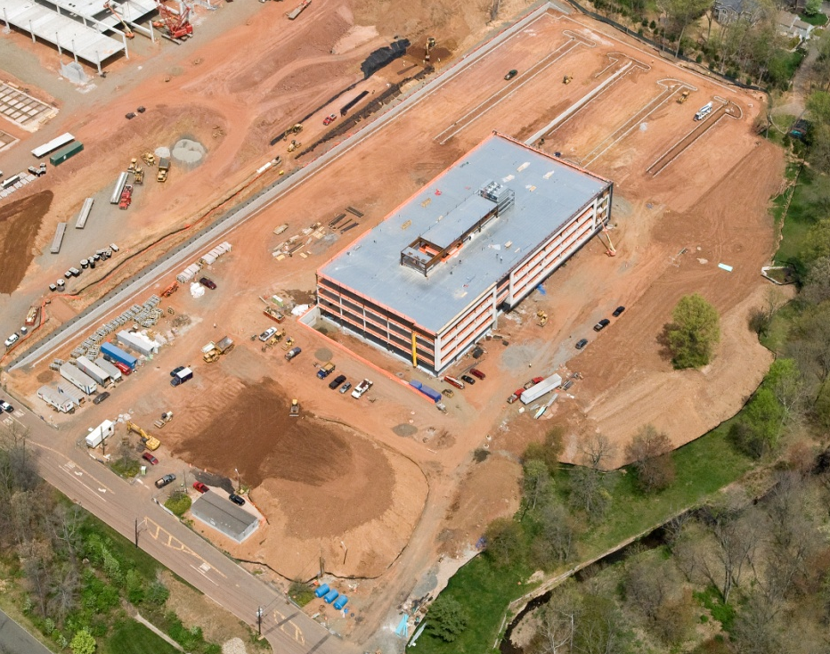
Background Info
Major Players:
Owner: Connell Real Estate & Development
CM: Turner Construction for Core & Shell
Architect: HLW International
General Data:
4 Story High End Office Building with Cafeteria
185,000 Total Square Feet
$38.9 Million Construction Cost
Dates of Construction (core & shell):
July 2007 to January 2009
50 Connell Drive
Berkeley Heights, NJ

Slide 5
Background Info
Location:
20 miles west of NYC & adjacent to I-78
50 Connell Drive
Berkeley Heights, NJ

Slide 6
Background Info
Structural:
Concrete Footings
Grade Beams
Structural Steel Frame
Composite Floor Slabs
Vertical Steel Cross Bracing
50 Connell Drive
Berkeley Heights, NJ

Slide 7
Background Info
Mechanical Systems:
Concealed Mechanical Penthouse
2 Air Cooled Condensing Units (ACCU’s) per floor
2 pipe direct return air/water system
2 AHU’s supply 100% OA to the ACCU’s
Mechanical Penthouse
50 Connell Drive
Berkeley Heights, NJ

Slide 8
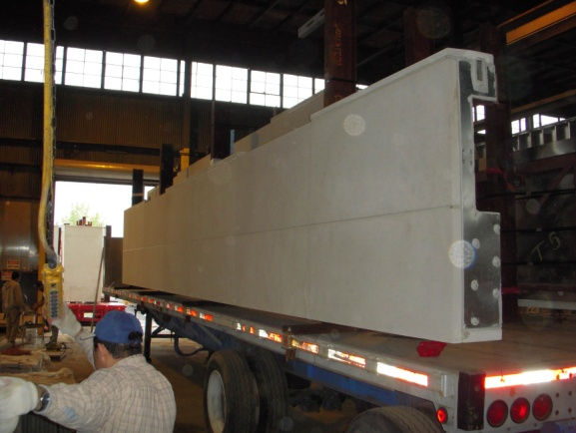
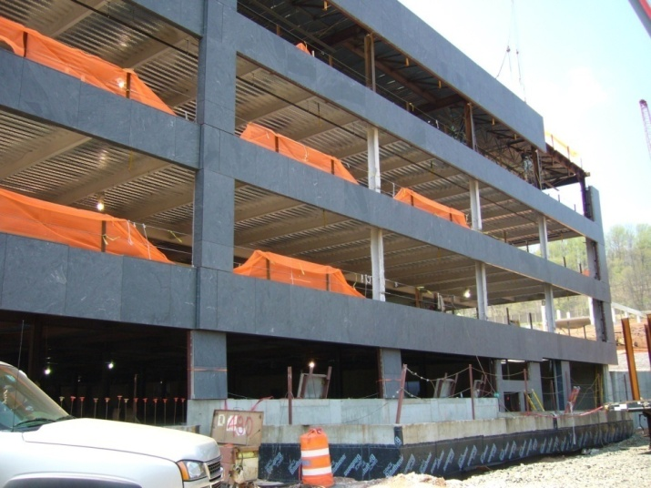
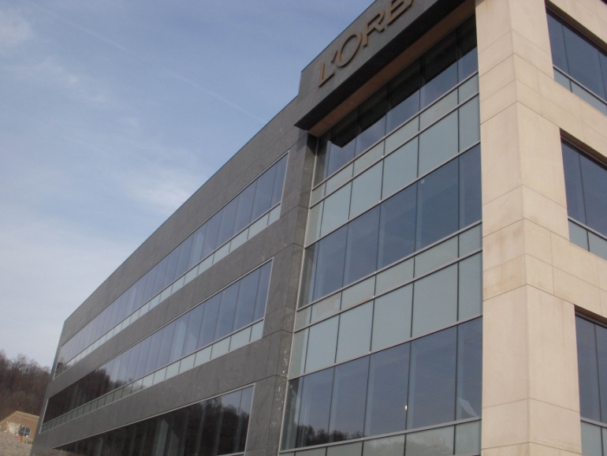
Panelized Facade System
1
2
3
4
50 Connell Drive
Berkeley Heights, NJ

Slide 9
Panelized Facade System
The Problem
The vertical joints between the window panels & stone panels were out of alignment
Each contractor blamed the other
20% of windows had to be removed
Correct Alignment
Misalignment Joints
50 Connell Drive
Berkeley Heights, NJ

Slide 10
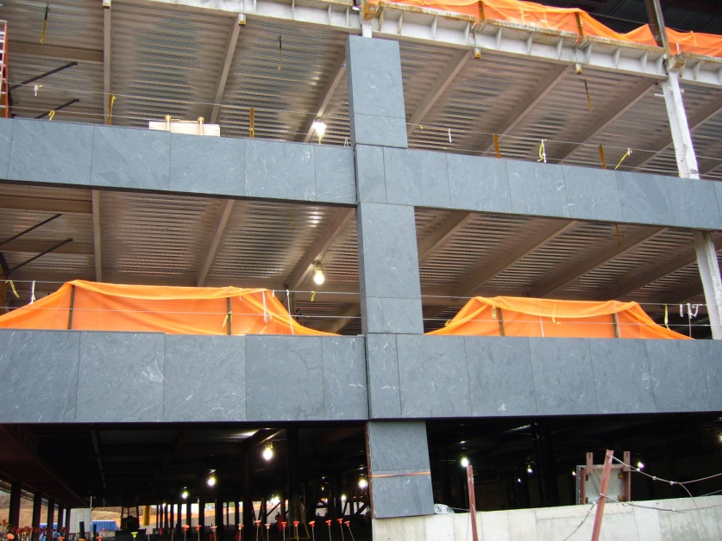
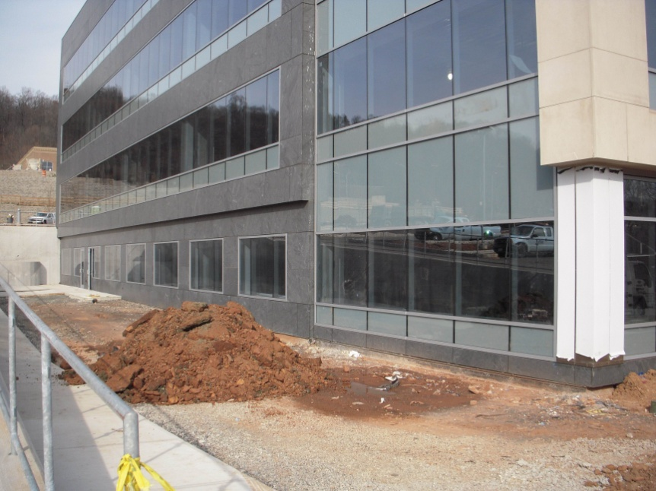
Panelized Facade System
Problem Statement:
Could using a single contractor for the façade prevented the alignment problems?
50 Connell Drive
Berkeley Heights, NJ

Slide 11
Integrated Contractor
Panelized Facade System
Potential Solution:
Advantages | Disadvantages
Less Coordination | Finding Qualified Bidders
Strong Incentive for Quality Work | Chance of Subcontracting a Work Package
Eliminates “Finger Pointing” | CM has less Control Over the Process
Subs Claim it is More Cost Effective | Unqualified Subcontractor May get Hired
Subcontractor would be More Likely to Work Through a Problem on Their Own | Subcontracting Defeats the Goal of Using An Integrated Contractor
50 Connell Drive
Berkeley Heights, NJ

Slide 12
Panelized Facade System
Conclusion: Using an integrated contractor is not feasible since the disadvantages have major implications
Shop drawing coordination is the key to success
Another Option:
Dedicated Quality Control Staff:
Probably would have caught problem sooner
$8,000 more per month
Regular field personnel could be just as effective
The experience was a lesson learned for everyone involved
50 Connell Drive
Berkeley Heights, NJ

Slide 13
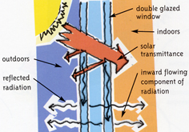
High Performance Glazing
Problem Statement
Can replacing the vision glass with a more
energy efficient glass result in long run energy
& equipment savings for the owner?
Methodology
Research and select a new type of glass
Perform energy modeling simulation
Compare costs
50 Connell Drive
Berkeley Heights, NJ

Slide 14
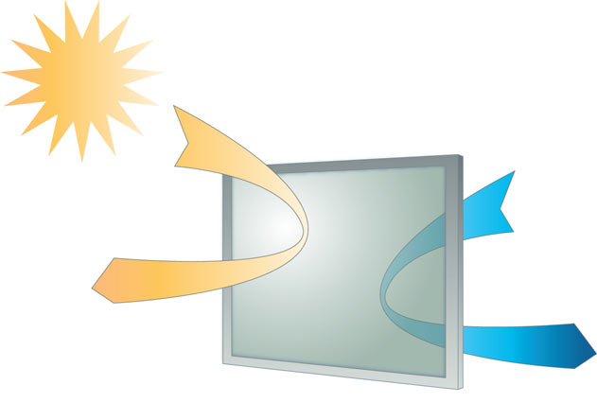
High Performance Glazing
Current Glass - YCW 750 Spline Tech
Proposed Glass -Solarban® 70XL
Product Description: SolarBan is a revolutionary new Solar Control, Low-E glass manufactured by PPG that has been recognized as one of the most energy efficient on the market
Glass | U-Value
SplineTech 750 | 0.45
SolarBan70XL | 0.26
SolarBan has a lower rate of heat transfer
50 Connell Drive
Berkeley Heights, NJ

Slide 15
High Performance Glazing
Material Cost Comparison:
Glazing Type | Square Foot Cost | Size of Panels (sf) | Cost per Unit | Number of Glass Units | Total Material Cost
Spline Tech | $10.45 | 35 | $365.75 | 589 | $215,427
SolarBan70XL | $9.25 | 35 | $323.75 | 589 | $190,689
Upfront Savings = $25,000
50 Connell Drive
Berkeley Heights, NJ

Slide 16
High Performance Glazing
Simulation Results
Glazing Type | Estimated Operating Expenses | Annual Operating Savings | Estimated Total Capital Cooling HVAC Costs | Initial Capital Cost Savings | 1st Year Savings
Spline Tech | $1.56/sf | N/A | $7.63/sf | N/A | N/A
SolarBan70XL | $1.41/sf | $25,500* | $6.34/sf | $1.29/sf | $244,800*
*Based on 170,000 sf of office space
The DOE’s 2.2 Building Energy Analysis Simulation Tool was
Used for this estimate
Over $200,000 saved in initial equipment cost
$25,500 saved per year in utility bills
SolarBan was used
on this university building
50 Connell Drive
Berkeley Heights, NJ

Slide 17
High Performance Glazing
Summary of Findings
Glazing Type | U- Value | Square Foot Cost | Cost per Unit | Total Glass Material Cost | Glass Material Cost Savings | Estimated Energy Reduction | Estimated Equipment Cost Reduction
Spline Tech | 0.45 | $10.45 | $365.75 | $215,427 | N/A | N/A | N/A
SolarBan70XL | 0.26 | $9.25 | $323.75 | $190,689 | $24,738 | 9% | 16%
Conclusion:
SolarBan70XL provides significant cost savings
9% Energy Reduction
16% Equipment Cost Reduction
SolarBan70XL should be used in place of SplineTech750
50 Connell Drive
Berkeley Heights, NJ

Slide 18
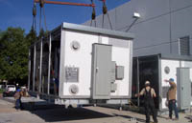
Prefabrication
Problem Statement:
Would replacing the mechanical equipment with a modular central plant
be beneficial for the project?
50 Connell Drive
Berkeley Heights, NJ

Slide 19
Prefabrication
What is it?
Modular Plants Combine
Chiller
Pumps
Cooling Tower
Interconnecting Pipes
All in one pre-assembled module
50 Connell Drive
Berkeley Heights, NJ

Slide 20
Prefabrication
Modular Central Plant vs. Site Built Plant
Advantages | Disadvantages
Reduced owner & contractor risk | Long lead time
Single source supplier | Heavy loads
Fast site assembly time | Structural coordination
Reduced trade coordination | Rigging & crane requirements
Less field labor required | Vibration isolation
Easily expandable | May need to locate on grade
50 Connell Drive
Berkeley Heights, NJ

Slide 21
Prefabrication
Rigging Requirements
66 Ton Equipment Weight
Must balance load
Multiple Spreader Bars & Shackles
1” Cables, 1” Shackles Minimum
Experienced Rigging Crew Essential
50 Connell Drive
Berkeley Heights, NJ

Slide 22
Prefabrication
Modular vs. Site Built Plants
Begin Start up and Testing
37 Days
50 Connell Drive
Key Assumption: 7 days to connect wiring & piping hookups
Berkeley Heights, NJ

Slide 23
Prefabrication
STAAD Analysis: Supporting W18x35 will deflect at least 2” = not acceptable
2 Options
Increase size of structural members = $$$
Locate on grade = Eyesore
Elevation of MCP Located on Grade
50 Connell Drive
Berkeley Heights, NJ

Slide 24
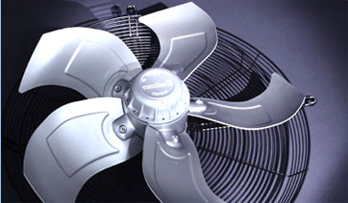
Prefabrication
Design Concern #1
High Volume of Air Required compared to the 8 ACCU’s
What does this mean?
MCP would require 185,000 CFM (total supply & return)
This requires 2 vertical shafts (supply & return) each measuring 6’ x 7’
Why is this Bad?
Too much floor space used – Lack of vertical shaft space
Large ductwork heavier & more expensive to construct & support
Supply & return fan would be required
Very high horsepower motors required for fans
50 Connell Drive
Berkeley Heights, NJ

Slide 25
Prefabrication
Design Concern #2
Service failure = no AC for entire building
Why is this bad?
The building is unoccupiable until the unit is fixed.
What about the current design?
2 units per floor provide cooling
If one unit fails the other unit can still cool the floor while the other is being repaired
All units are required only for peak design load
50 Connell Drive
Berkeley Heights, NJ

Slide 26
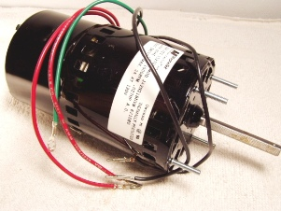
Prefabrication
Design Concern #3
Replacement parts are large must be special ordered
What does this mean?
Must keep parts in stock or wait until they arrive for service
Why is this bad?
Long lead time
The building may be without cooling capabilities for an extended period of time
Example:
Replacement motors for the fans are very large
and may require a crane.
The parts for the actual equipment are smaller and easily attainable.
50 Connell Drive
Berkeley Heights, NJ

Slide 27
Prefabrication
Conclusion
A modular plant is not a good option for this building
Why?
Even though it has a faster installation time the disadvantages create bigger problems.
50 Connell Drive
Berkeley Heights, NJ

Slide 28
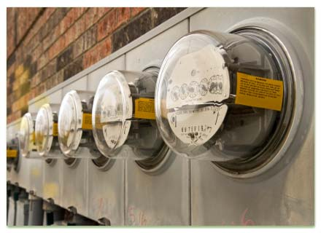
Reducing Operating Costs
Critical Industry Issue
Energy Costs are expected to rise dramatically in the next decade
Techniques to Reduce Costs
Energy modeling prior to construction
Use of efficient equipment & water efficient fixtures
Take advantage of state rebates for efficient equipment
Energy monitory
Optimizing operating set points
Continuous commissioning
50 Connell Drive
Berkeley Heights, NJ

Slide 29
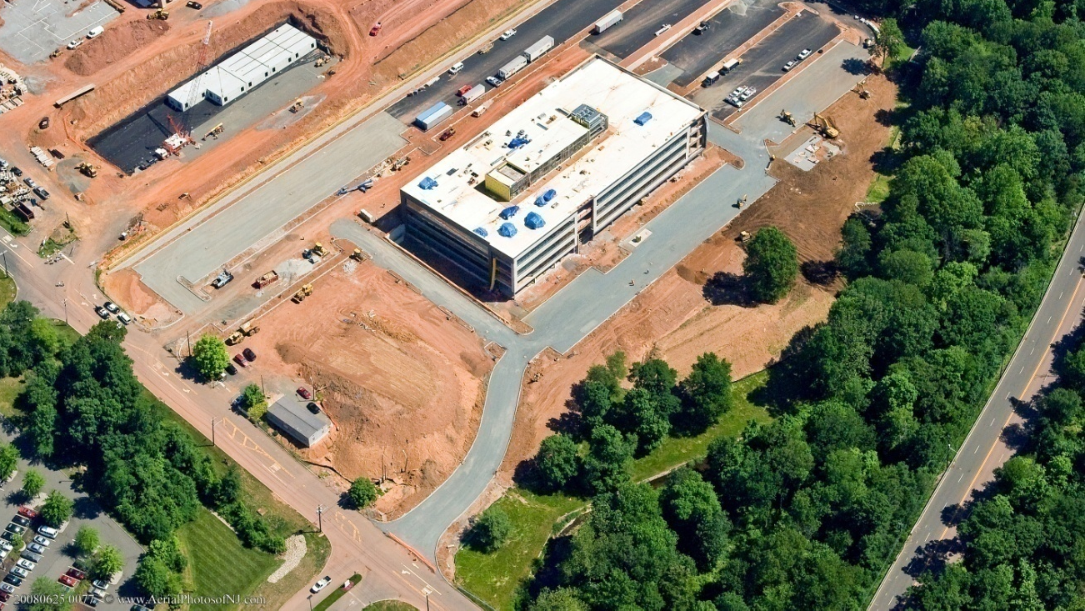
The End
Questions or Comments?
50 Connell Drive
Berkeley Heights, NJ

